Slide 1
React
Shan-Hung Wu & DataLab
CS, NTHU

Slide 2
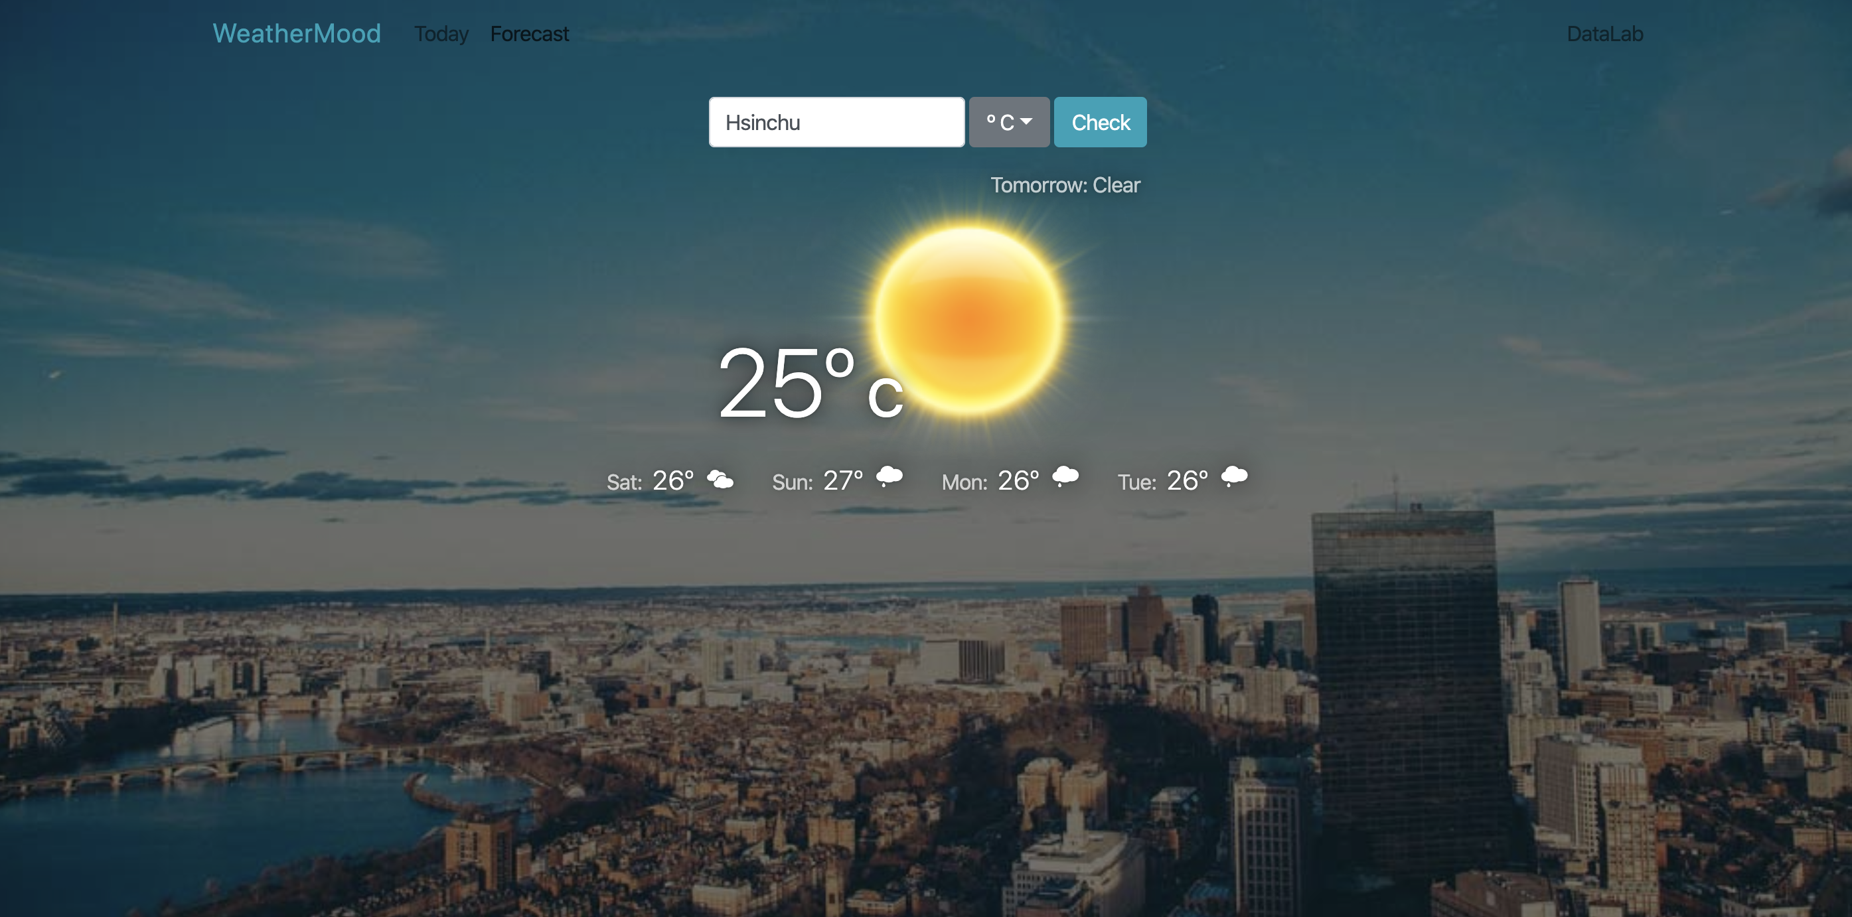
WeatherMood: Forecast
First day (Tomorrow’s weather)
First day (Tomorrow's temperature)
Second to the fifth day (Weather table component)

Slide 3
Requirements
Use the 5-days forecast API
Show “tomorrow” in ForecastDisplay
WeatherTable for the rest days
Each day in WeatherTable:
Day of week: “Sat,” “Sun ,” “Mon,” and so on
Temperature in correct unit
Weather condition icon (based on code)
Responsive: show only 2 days in WeatherTable on portrait mobile devices

Slide 4
